Slide 1
About the Instructor
Dr. Cox is the instructor for 6th-Grade Vanguard Science.
Teaching Philosophy:
Assume students knows nothing about a subject.
Emphasize basic concepts to build a strong foundation for employing higher-order thinking skills and applying scientific method.
Relevant Background
Twenty-two years teaching middle school science for HISD.
Sixteen-years teaching 6th-grade science at T.H. Rogers.
Holds degrees in Microbiology (BS), Pathogenic Microbiology (MS); & Genetics(Ph.D.).
Work experience in biochemistry, environmental science, and microbiology in the academic, private and government sectors.

Slide 2
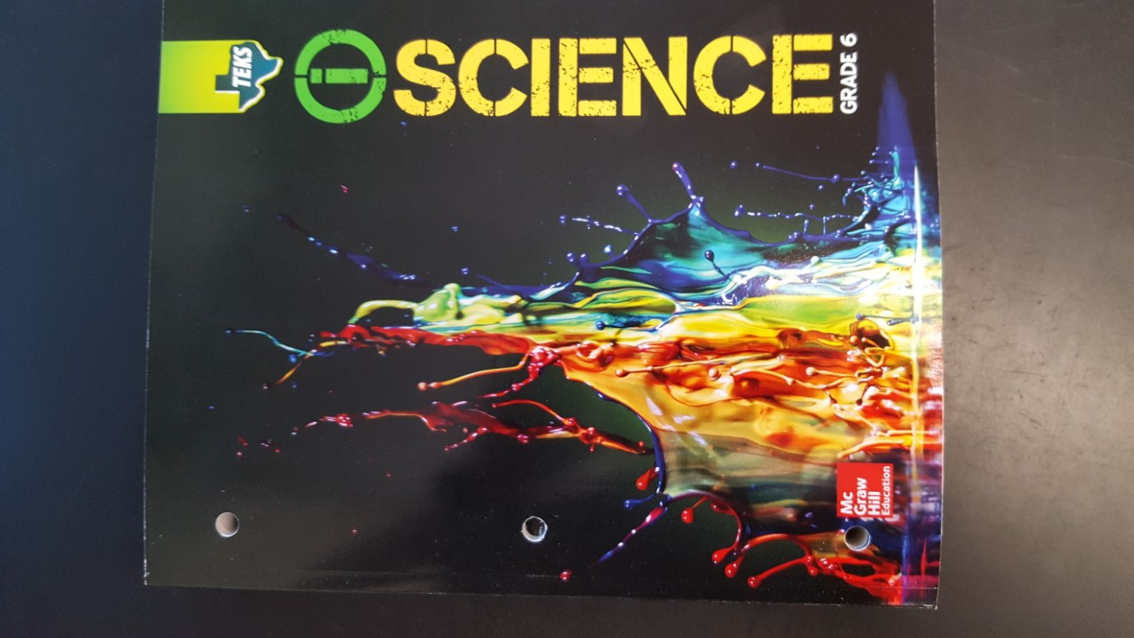
How Does Teaching and Learning Take Place?
Teaching occurs by short lectures, reading, discussions, activities, PowerPoints, hand-outs, videos, warm-ups, textbook, projects, and online platforms such as Quizizz and Quizlet
PowerPoints are available through Canvas Announcements
Online books (CK 12 e-Books) and other resources are available through Canvas
The sixth-grade science textbooks just arrived!
Student have been assigned a (McGraw Hill) textbook to take home. Permanent property of student.

Slide 3
Presentation of Learning Material
Sixth-grade Vanguard Science will cover and enrich the sixth-grade HISD Objectives.
80% is physical science and 20% biological science The following topics will be covered in order:
Laboratory Safety
Metric Measurement;
Scientific Method;
Introduction to Science and Matter
Atoms and the Periodic Table (includes ionic and covalent bonding to form compounds)
Force and Motion Energy (Newton’s Laws of Motion)
Earth Science (layers, volcanoes, deep-sea vents, earthquakes, seafloor spreading, continental drift)
Earth’s Atmosphere (structure/function of layers, extreme weather events, weather mapping)
Solar System and Spaceflight
Animal and Plants Cells: Structure and Function of organelles
independence of Living Systems and Ecosystems.
The material will be present through lectures and discussion, reading, activities, projects, worksheets, Study Island assignments

Slide 4
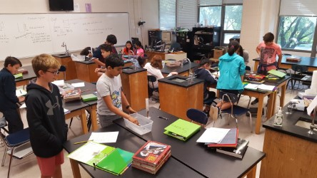
Grading System
The following is the HISD grading scale:
A = 90-100
B = 80-89
C = 70-75
D = 70-74
F = 69 and below
Assignments are categorized as either:
Learning grades count 70%
Daily work, quizzes, homework
Assessments grades count 30%
Examinations, Projects and other Assessments
Late work is reduced by 10%
Over 2-weeks late, not accepted and a zero is given for assignment

Slide 5
Class Rules and Classroom Management
CLASS RULES
Be on time for class
Bring necessary materials to class
Raise your hand to speak
Always observe laboratory safety rules
Comply with the school honest policy

Slide 6
Communication
Contact Information:
Office Hours: "A" days from 11 am to 11:30 am
Telephone: 713/917-3570 (West Office)
Email: jcox@houstonisd.org
Website: https://sites.google.com/d/1gwSo5ZvQKGmK9CrIkOdrovtnPvIk-4JH/p/1zUyjICgVxmrvrfAENWryjZm9ox_IrhO8/edit

